Slide 1



Welcome
Agenda
9:00 – 9:15 am Registration & Breakfast
9:15 – 9:45 am Basics of Crop Insurance & FFT
9:45 – 10:15 am How to get a crop insurance quote online
10:15 – 10:30 am Break
10:30 – 11:30 am Indemnities & Excel tool
Please do not forget to fill out the pre-workshop assessment

Slide 2
Crop Insurance Training
Florida Fruit Tree Policy
Edward “Gilly” Evans & Fredy H Ballen
UF/TREC

Slide 3
Introduction
Objectives:
Learn/refresh crop insurance concepts.
Learn about the Florida Fruit Tree policy & endorsements.
Learn to evaluate different crop insurance scenarios.
Take action & minimize your production risk.

Slide 4
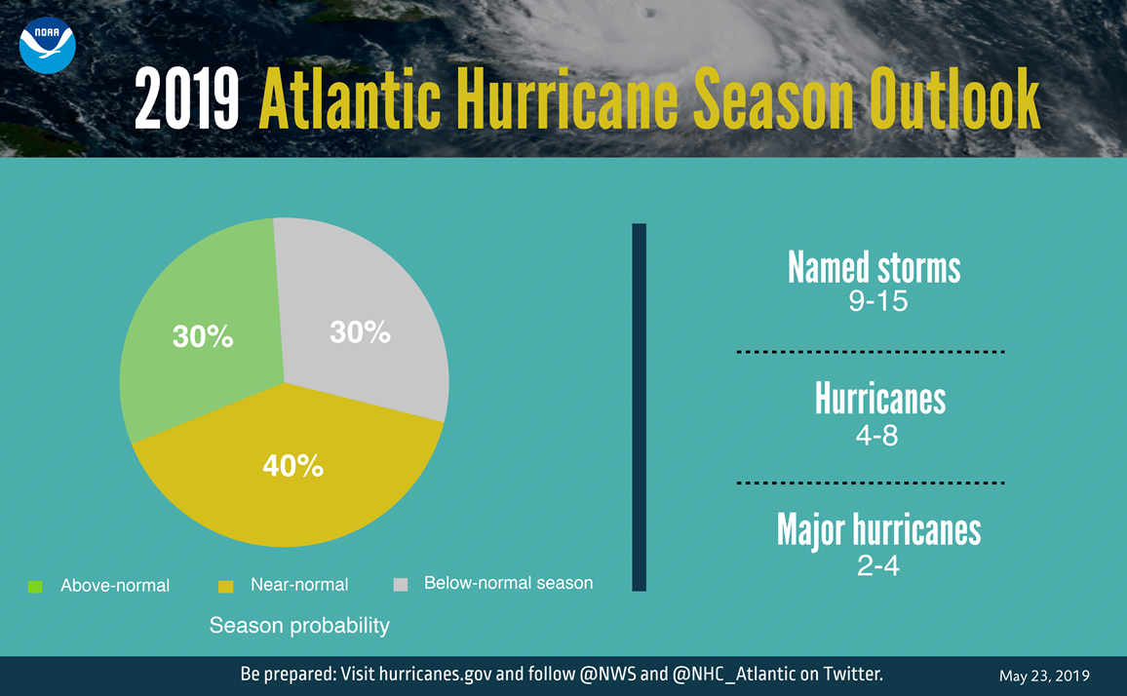
Introduction

Slide 5
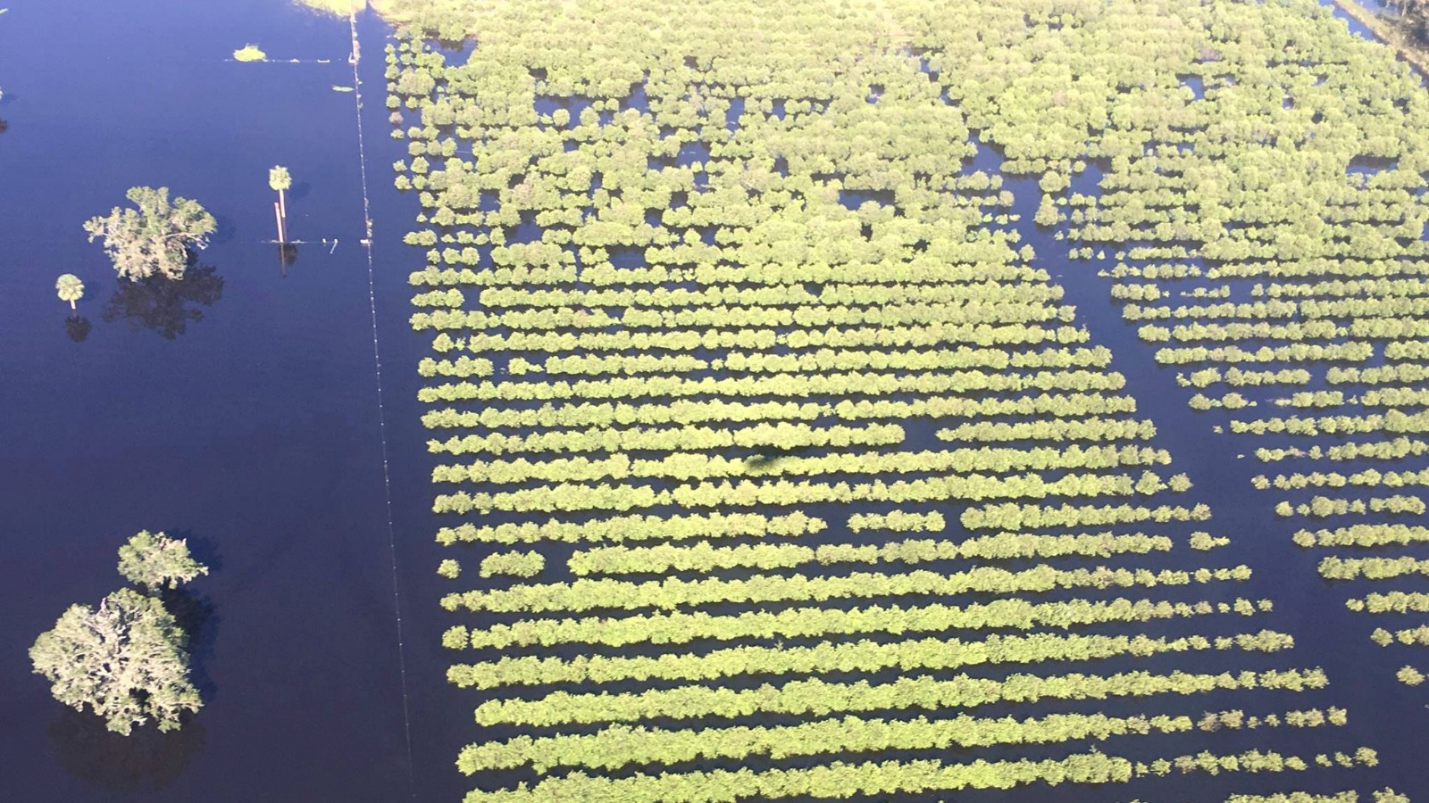

Slide 6
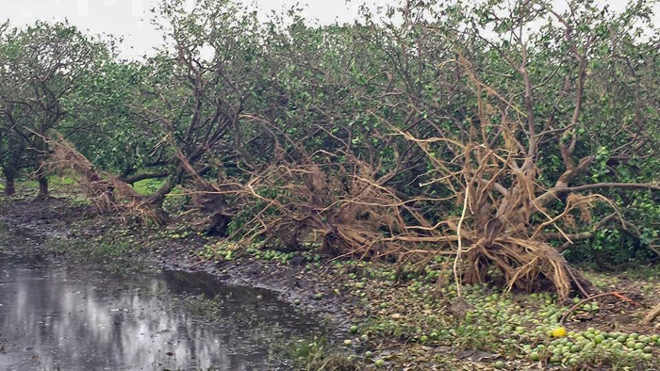

Slide 7
Introduction
Background
The Florida Fruit Tree crop insurance program was created in 1996; later in 2017, it was designated as a permanent program.
Similar to other types of insurance, producers are able to select the coverage and structure of their crop insurance policy according to their specific risk management needs.

Slide 8
Introduction
The Florida Fruit Tree policy covers:
Avocado trees;
Carambola trees;
Grapefruit trees;
Lemon trees;
Lime trees;
Mango trees;
Orange trees (includes early, mid, and late-season navel and temple); and
Other citrus trees (includes tangerine, tangelo, and murcotts)

Slide 9
Introduction
Florida Fruit Trees are not insurable if they:
(1) Have been grafted within a 12-month period before the date insurance attaches, unless the grafting is a result of topworking;
(2) Are non-grafted seedlings (grown from seed);
(3) Are unsound, diseased, or unhealthy;
(4) No longer have the potential to produce a yield typical of healthy trees of the same age, unless such trees were topworked or buckhorned and qualify as stage I or II;

Slide 10
Introduction
Florida Fruit Trees are not insurable if they:
(5) Are toppled; or
(6) Were damaged before the beginning of the insurance period (If trees suffered damage the previous crop year, then insurance will not attach until the previous year’s damage is determined, you submit a revised acreage report, and the trees are accepted by the FCIC.

Slide 11
Introduction
Florida Fruit Tree Policy Definitions
Tree Stage
A tree classification system (stage I,II,III) is used in the FFT policy.
(a) Orange, grapefruit, lemon, lime, other citrus, avocado, and mango may qualify for stage I if trees were:
Set out less than three crop years,
Buckhorned or topworked less than two crop years, or
Reset after having been toppled less than one crop year prior to the beginning of the current crop year.

Slide 12
Introduction
a) Orange, grapefruit, lemon, lime, other citrus, avocado, and mango trees may qualify for stage II if they were:
Set out three or more crop years,
Buckhorned or topworked two crop years or more, or
Reset after having been toppled less than two crop years prior to the beginning of the current crop year.

Slide 13
Introduction
a) Orange, grapefruit, lemon, lime, other citrus, avocado, and mango trees may qualify for stage III if they are:
Are able to produce a yield typical of a healthy tree of the current tree age, except that:
(i) Citrus, avocado, and mango trees will not qualify for stage III until after the sixth crop year after set out; and
(ii) Citrus, avocado, and mango trees will not qualify for stage III until after the fourth crop year after buckhorning or topworking.

Slide 14
Introduction
Counties Available
Avocado and Mango - Miami Dade County.
Carambola - Lee and Miami Dade counties.
Lemon - Hendry and Martin counties.
Lime - Lee and Miami Dade counties.
Grapefruit, Orange and other citrus trees are insurable in 28 counties. See your crop insurance agent/actuarial info for more details.

Slide 15
Introduction
Causes of Loss
You are protected against the following:
Freeze;
Wind;
Excess moisture;
Flooding due to high groundwater levels, if allowed by the special provisions; and
Insects, diseases, and other pathogens, if allowed by the special provisions.

Slide 16
Introduction
Insurance Period
For carryover policies, insurance begins for each crop year on June 1 when an acreage report is submitted by the sales closing date.

Slide 17
Introduction
Insurance Period
For new policyholders, insurance coverage begins:
June 1 when a newly completed application is received by the sales closing date and all other policy requirements are met; or
30 days after the company receives your completed application (applications received after the sales closing date), subject to all other requirements of the policy.
The insurance period ends with the earliest occurrence of one of the following:
May 31; or the total destruction of the insured trees.

Slide 18
Introduction
Important Dates (crop year 2020)
Sales Closing & Acreage Reporting : April 15, 2019 (carryover policies)
Cancellation: May 31, 2019 (carryover policies)
Policy starts: June 1, 2019
Premium Billing: March 1, 2020
Termination: May 31, 2020

Slide 19
Introduction
Actuarial Information
Any grower interested in the latest information on dates, reference prices and other relevant information may want to visit the USDA actuarial information page at
https://webapp.rma.usda.gov/apps/actuarialinformationbrowser/

Slide 20
Basic Concepts
Insurance Unit
Each parcel of land for which premiums are calculated.
Usually the FFT policy only considers two types of units: basic and optional.
Basic unit: includes owned land, cash rents, and crop sharing.
Optional unit: it allows insurance to be customized according to risk management needs. For example subdivided basic units (irrigated/non irrigated, by section). Optional units carry a premium surcharge of about 10%.

Slide 21
Basic Concepts
Crop Insurance Coverage
Catastrophic Risk Protection (CAT) is the most basic coverage option. Coverage is set up at the 50% level and 55% of the maximum reference dollar amount for the appropriate tree stage.
If the maximum reference dollar amount is $50 per tree, and there are 100 trees in the grove, the CAT coverage results in a $1,375 ($50*100*0.5*0.55) guarantee for a 100 trees grove.
The cost for CAT coverage is an administrative fee of $300 per crop per county, which the grower must pay in order to be eligible, regardless of the acreage.

Slide 22
Basic Concepts
Crop Insurance Coverage
Any coverage above CAT is considered buy-up coverage.
Coverage levels range from 50 to 75% of the total value, which is based on the number of trees at different stages, and the reference prices per tree as shown on the actuarial information.
If the maximum reference dollar amount for a tree stage II is $103/tree and there are 100 trees in the grove, a 65 percent coverage level results in a $6,695 guarantee ($103/tree * 100 trees * 65%) for the 100 trees grove.

Slide 23
Basic Concepts
Insurance Premium
The premium is the cost paid by the grower for crop insurance protection; premiums are set by the USDA/RMA.
The premium depends on the desired coverage level (usually from 50 to 75 percent), and the maximum reference dollar amount per tree.
For the crop year 2020, the crop insurance premium is due on March 1, 2020 or when an indemnity payment is received, whichever comes first.
To encourage crop insurance adoption, a percentage of the premium is subsidized by the Federal government.

Slide 24
Basic Concepts
Table 1. Crop insurance premium subsidies and producer premiums based on coverage level

Slide 25
Basic Concepts
Insurance Deductible
It is the loss limit that you, as a crop insurance policy holder must absorb before benefits from the insurance policy are paid.
The policy generally pays all the losses beyond the deductible; crop insurance deductibles range from 25 to 50 percent in 5 percent increments.
Insurance Indemnity
Technically, losses occur when trees are damaged or destroyed as result of one or more of the insurable causes of loss.
After experiencing losses, if the damage value is greater than the deductible, usually the grower receives a net indemnity.

Slide 26
FFT Policy Endorsements
Florida Fruit Tree Policy Endorsements
For an additional premium, the Florida Fruit Tree policy offers the Occurrence Loss Option and the Comprehensive Tree Value as policy endorsements for additional protection.
Occurrence Loss Option (OLO):
Under this endorsement, the insurance deductible is eliminated; it uses a 5 percent unit value to estimate indemnities.
If the insured damage value exceeds the 5 percent unit value, then the insured damage value is payable; if the insured damage value is less than the 5 percent of the unit value, there is no claim.
You must select the OLO endorsement when you apply for insurance or by the sales closing date (carryover policies).

Slide 27
FFT Policy Endorsements
Comprehensive Tree Value (CTV)
It allows for the future value of destroyed or fully damaged trees.
The CTV endorsement is not available for carambola, lemon, lime, mango or stage I trees.
Only trees in Stage II and Stage III blocks considered fully (100%) damaged or destroyed are eligible for an indemnity under this endorsement.
You must choose the CTV endorsement when you apply for insurance or by the sales closing date (carryover policies).

Slide 28
FFT Policy Endorsements
For trees considered destroyed, in order to receive the full indemnity under the CTV endorsement:
(a) You must plant an equivalent number of trees within three calendar years of the date of the removal or destruction, unless otherwise specified on the S. P.;
(b) The trees you plant do not have to be the same crop as the destroyed trees, but they must be grown to produce fruit, intended to be sold for human consumption; and
(c) The trees must be planted according to recognized good farming practices and in an area within the state of Florida that the FCIC considers to be suitable for production of the specific fruit crop.
(d) You will receive 50% of the indemnity within 30 days after your claim is approved; the remaining 50% will be paid after meeting the requirements of this section.

Slide 29
II. Crop Insurance Premium Estimator

Slide 30
Crop Insurance Premium Estimator
Premium estimator:
Any grower interested in obtaining a crop insurance quote for his operation may use the USDA/RMA online insurance premium estimator for that purpose.
Please keep in mind that your actual premium will depend upon your specific conditions and exclusions; refer to your crop insurance agent for more details.

Slide 31
Crop Insurance Premium Estimator
Crop insurance premium example I
A grower wants to insure 1,000 Navel orange trees stage I, 1,000 Navel orange trees stage II, and 1,000 Navel orange trees stage III. The grower has a 100 percent interest in the crop (i.e., the grower is not sharecropping).
What would be the premium for crop year 2020, assuming a 75 percent coverage level?
What would be the premium if the grower wants a 75 percent coverage level under the OLO endorsement?

Slide 32
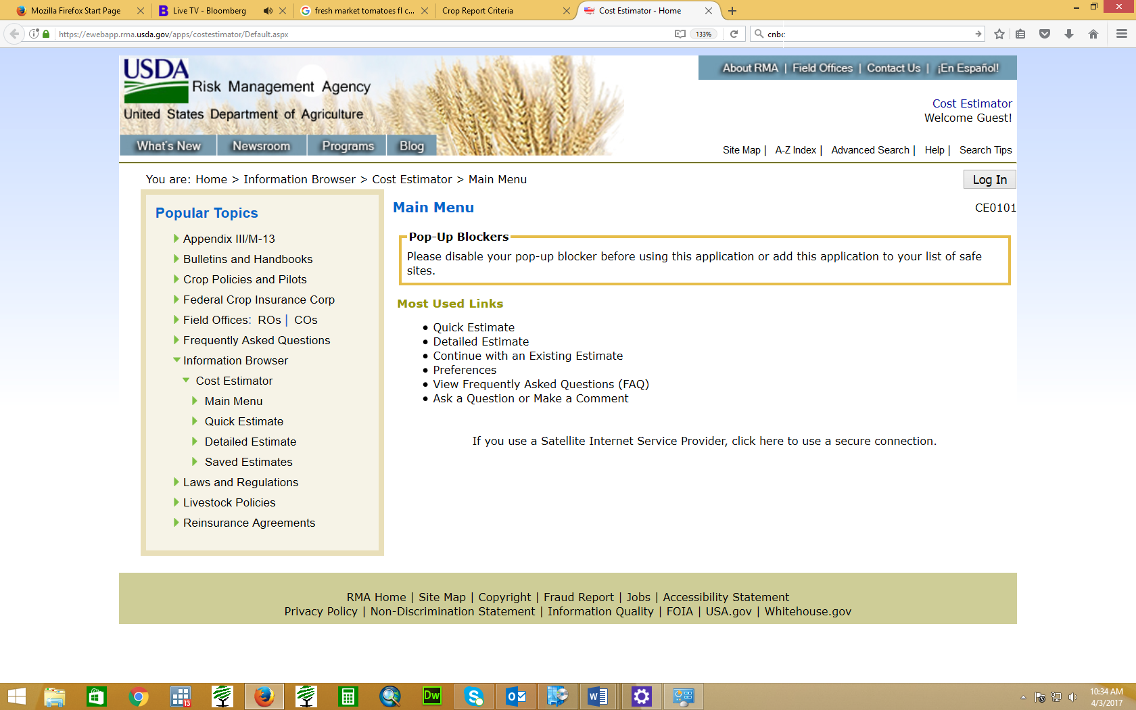
Crop Insurance Premium Estimator
Step 1: Open the cost estimator at https://ewebapp.rma.usda.gov/apps/costestimator/Default.aspx
After loading the web page, please disable your pop-up blocker (see website message example below)

Slide 33
Crop Insurance Premium Estimator
Crop insurance premium example II
In this scenario, it is assumed the grower wants to insure 1,000 Grapefruit trees (Colored type) in full production (Stage III) grown on a basic unit in Hendry County, the grower has a 100 % interest in the trees.
What would be the premium for crop year 2020, assuming a 70 percent coverage level?
What would be the premium if the grower wants a 70 percent coverage level under the OLO endorsement?

Slide 34
III. Estimating Indemnity Payments

Slide 35
Estimating Indemnity Payments
Calculating Indemnities
Indemnities (insurance payouts) are received only if the actual damage/losses are higher than the insurance deductible.
If the actual damage/losses are equal or less than the insurance deductible, there is no indemnity payment to the insured grower.

Slide 36
Estimating Indemnity Payments
Calculating Indemnities
Example: A grower anticipates an active hurricane season and purchases the Florida Fruit Tree base policy for 10,000 stage III Navel orange trees with a 75 percent coverage level.
Now, let’s assume that wind damage during the month of September damaged 5,000 trees, and the damage was estimated at about 70%.
What would be the indemnity payment (if any) under the current crop insurance policy?

Slide 37
Estimating Indemnity Payments
Calculating Indemnities
Step (1): Determine the unit deductible
# of trees insured* tree reference value* (100 - coverage level %)
10,000 trees* $87 (reference value stage III)*25% (deductible) = $217,500
Step (2): Determine the damage value:
# of trees damaged* tree reference value* % damage level
5,000 trees damaged* $87 (reference value stage III)*70% (damage %) = $304,500

Slide 38
Estimating Indemnity Payments
Calculating Indemnities
Step (3): Calculate indemnity value; if the amount in Step 3 is positive, the grower receives an indemnity payment.
Damage value – unit deductible
$304,500- $217,500= $87,000 indemnity
From this example is clear that the grower is covering part of the losses, but what would be the situation if the grower had decided to add policy endorsements to minimize his risk even more?
These questions will be answered next.

Slide 39
Estimating Indemnity Payments
Florida Fruit Tree Crop Insurance Excel Tool
If you want to learn more about the FFT policy, you can use the Excel tool FFTC.xlsx (available at http://agecon.centers.ufl.edu/cropins1.html) to simulate different insurance scenarios covered by the Florida Fruit Tree policy, including the CTV and OLO endorsements.

Slide 40
Estimating Indemnity Payments
Florida Fruit Tree Crop Insurance Excel Tool
Disclaimer: this excel tool includes the producer premium but it does not account for Administrative and Operating payments (A&O) and other administrative fees charged which result in a slightly higher producer premium; for a detailed crop insurance quote, please contact your crop insurance agent.

Slide 41
Estimating Indemnity Payments
Previous example:
A grower anticipates an active hurricane season and purchases crop insurance (Florida Fruit Tree base policy) for 10,000 stage III Navel orange trees with a 75% coverage level.
Now, let’s assume that wind damage during the month of September damaged 5,000 Navel orange trees, and the damage was estimated at about 70% (crop insurance adjuster).
What would be the indemnity payment (if any) under the current crop insurance policy?

Slide 42
Estimating Indemnity Payments
Florida Fruit Tree Crop Insurance Case Study I
Suppose that a grower in Hendry County owns a non–organic colored grapefruit grove grown in a basic unit. He plans to insure his grove: 1,000 grapefruit trees stage II, and 1,000 grapefruit trees stage III. He purchases the FFT crop insurance policy with a 75% coverage level, and to minimize even more his risk he may purchase the Occurrence Loss Option (OLO) or the Comprehensive Tree Value (CTV) endorsement.
Later during the crop season; his grove suffers freeze damage, 1,000 stage II grapefruit trees have 50% damage, and 1,000 stage III grapefruit trees have 50% damage.
What would be the premiums and the indemnity payments for the FFT base policy? What would be the premiums and the indemnity payments under the OLO and CTV endorsement options?

Slide 43
Estimating Indemnity Payments
Florida Fruit Tree Crop Insurance Case Study II
A grower in Hendry County owns a non–organic Navel oranges grove grown in a basic unit; he plans to insure 1,000 Navel orange trees stage II, and 1,000 Navel orange trees stage III. He purchased the FFT crop insurance policy with a 70% coverage level, and to minimize even more his risk he may purchase the Occurrence Loss Option (OLO), or the Comprehensive Tree Value (CTV) endorsement.
Later during the crop season, his grove suffers extensive wind damage, 1,000 stage II Navel trees have 75% damage, and 1,000 stage III Navel trees are completely destroyed.
What would be the premiums and the indemnity payments for the FFT base policy and under the OLO and CTV endorsement options?

Slide 44
Concluding Remarks
Crop insurance should be viewed as a financial risk management tool to protect you from catastrophic events.
It should not be viewed as supplemental income or as a potential source of income.
Having crop insurance may be the difference between surviving a bad year or going out of business.
While an indemnity payment helps minimize losses significantly, there will still be losses, although much smaller compared to the case of no crop insurance at all.

Slide 45
Concluding Remarks
The decision to obtain crop insurance involves certain tradeoffs related to coverage level, insurance guarantee, and its associated costs.
This issue is even more complex when considering the extra cost of additional protection such as policy endorsements.
In the end, it depends on risk tolerance, short-term expectations, and the availability of financial resources to stay afloat if a catastrophic event occurs.

Slide 46
QUESTIONS
Please do not forget to fill out the post-workshop assessment.
Thank you

